Slide 1
Essential Question:
  What are the differences among the New England, Middle,
  & Southern colonies?
CPUSH Agenda for Unit 1.3:
  “Compare the British Colonies” notes

Slide 2
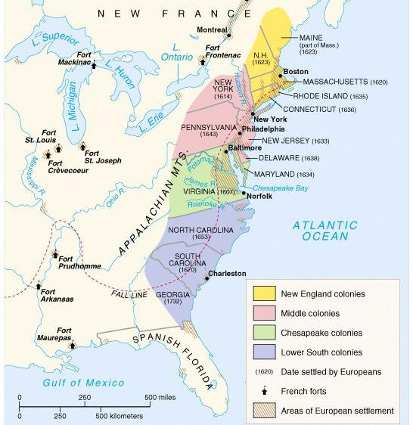
America: Story of Us
Jamestown (7.40)
Notes:
Explain Virginia’s development; include the Virginia Company, tobacco cultivation, relationships with Native Americans such as Powhatan, development of the House of Burgesses, Bacon’s Rebellion, and the development of slavery.

Slide 3
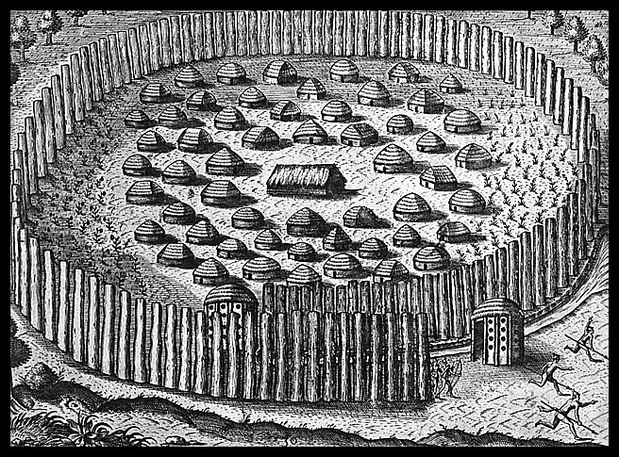
In 1585, Britain established Roanoke colony in North Carolina. The first British colony in North America.
No one knows exactly what happened to the Roanoke colony

Slide 4
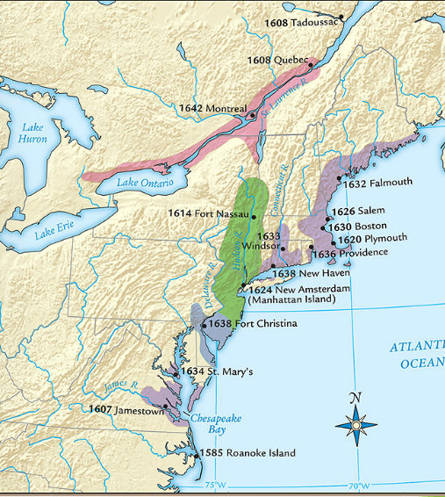
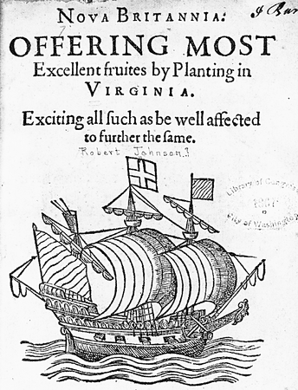
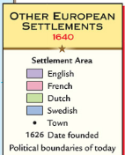
In 1607, settlers founded Jamestown the
first permanent British colony in America along
the Chesapeake Bay in present-day Virginia
Quick discussion:
How did the settlers gain rights and money to create a colony?
Jamestown was founded by British entrepreneurs of a joint-stock company called the Virginia Company
In 1606, Virginia Company investors gained a charter from the king, recruited settlers, and sent them to America in search of gold

Slide 5
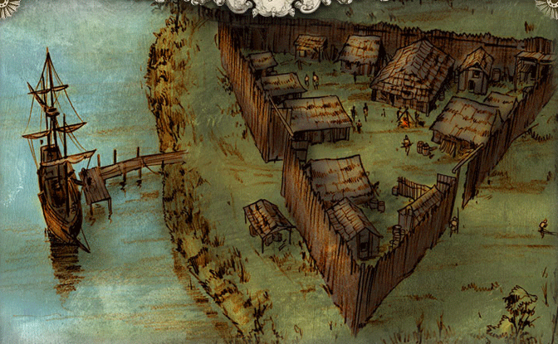
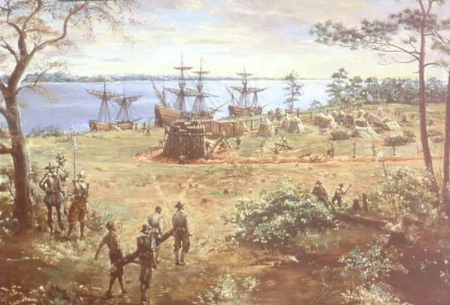
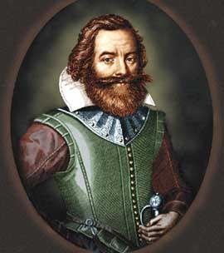
Settlers built a fort, but struggled to survive in their first years in America
Settlers arrived looking for gold and did not prepare to stay long; They did not plant crops & faced the “Starving Time”
John Smith took control & forced settlers to farm
“He who will not
work, will not eat”
Notes:
Clash of cultures; settlers had no experience in founding a settlement-they simply did what they knew. This did not work

Slide 6
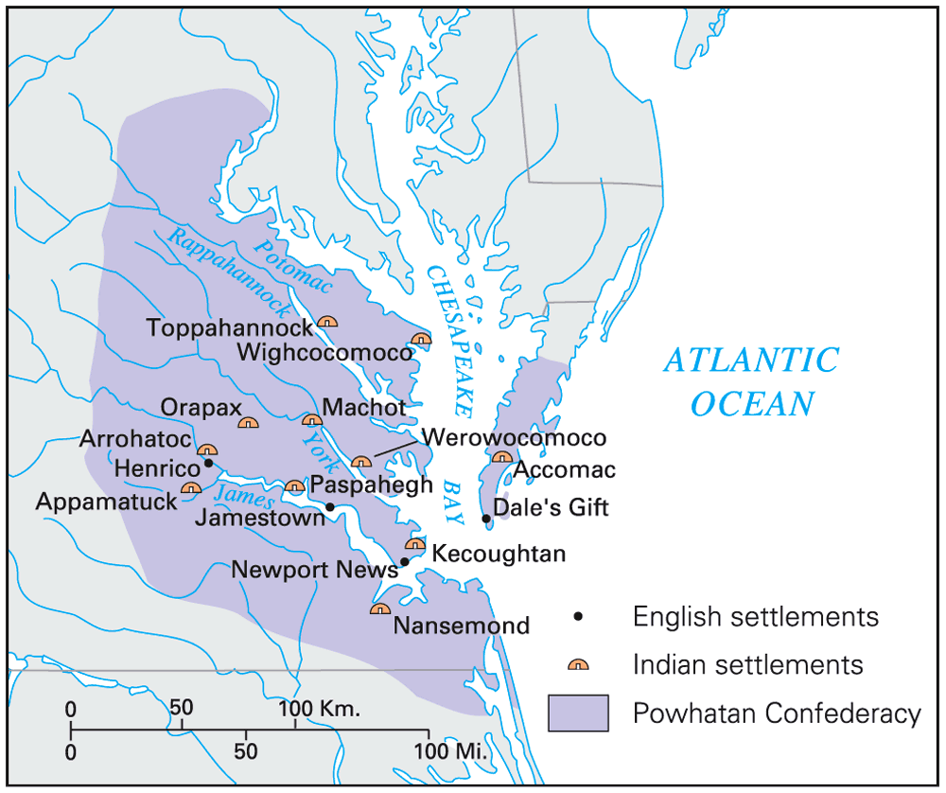
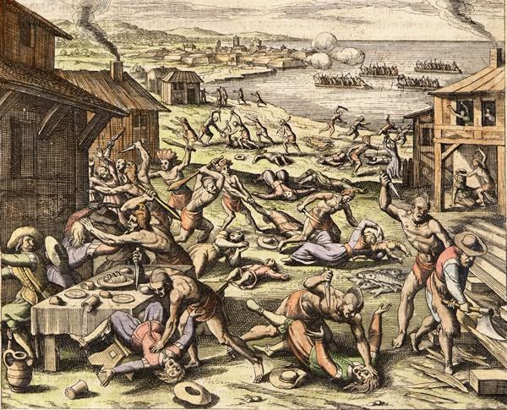
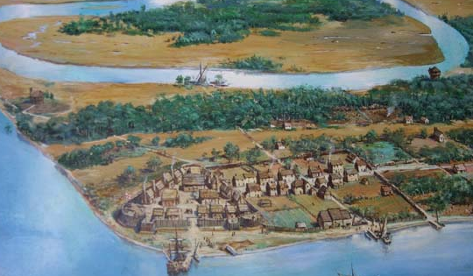
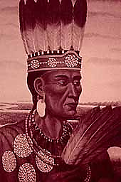
Jamestown was located on a swamp & led to outbreaks of disease among colonists
Jamestown was located in territory controlled by the Powhatan Indians who attacked the settlement
Notes:
The 1622 Powhatan uprising killed 347 Jamestown colonists

Slide 7
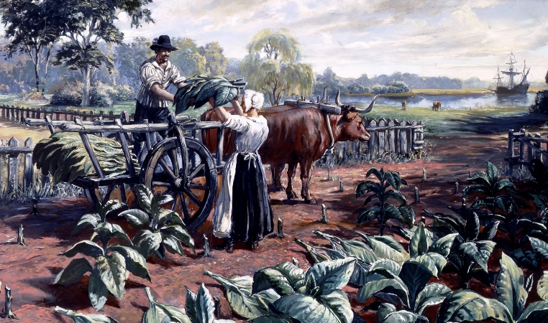
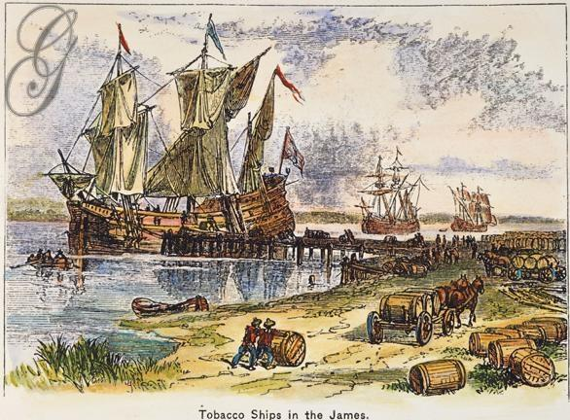
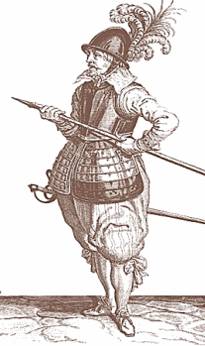
After the Jamestown colonists failed to find gold, the joint-stock investors demanded that colonists
find a way to make money
In 1612, John Rolfe introduced tobacco in Jamestown which was popular in Europe & made investors money
Notes:
explain Virginia's development including the Virginia Company, tobacco cultivation, relationships with Native Americans such as Powhatan, development of the House of Burgesses, Bacon's Rebellion, and the origins of American slavery

Slide 8
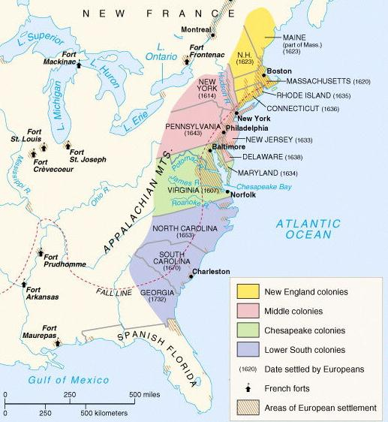
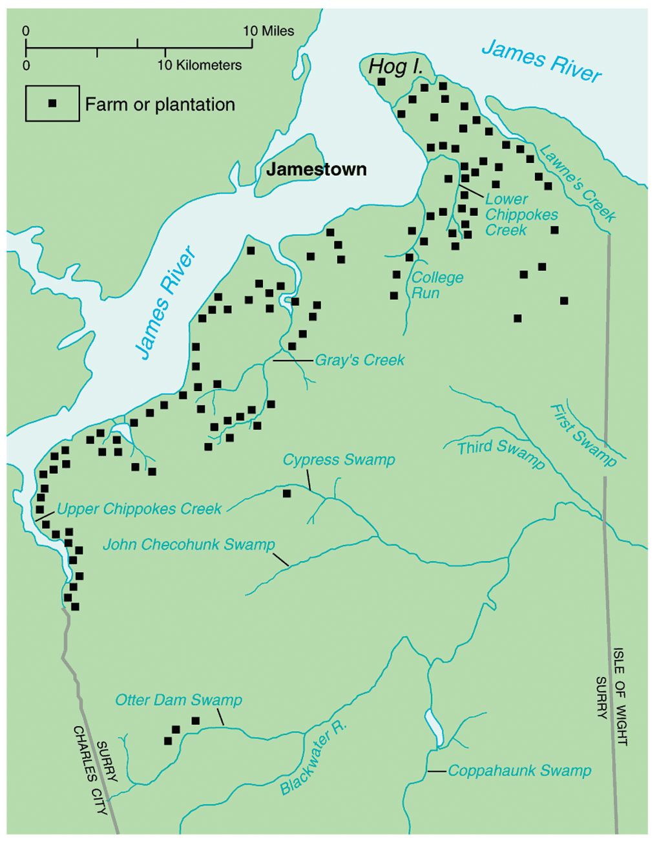
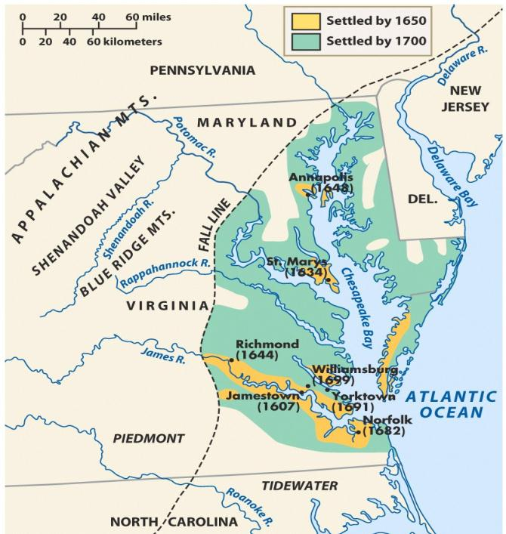
Tobacco was so profitable that colonists planted more, built large plantations, & expanded into new farm lands
Due to the success of tobacco,
the Jamestown settlement expanded into the Virginia colony

Slide 9
Quick discussion: How did Jamestown settlers
find enough workers to plant, harvest, and
package large amounts of tobacco?

Slide 10
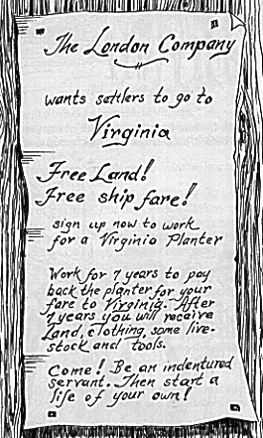
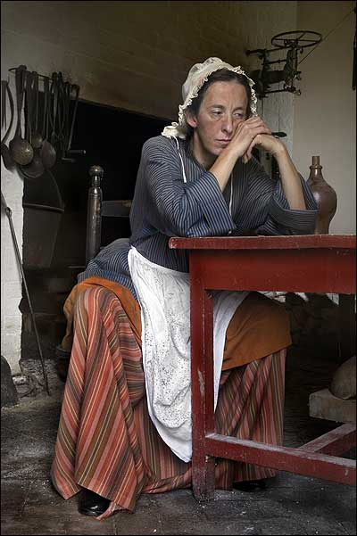
Tobacco created a need
for field laborers to plant
& pick the tobacco
To meet the demand for workers, landowners in Virginia used indentured servants from England
Indentured servants were typically poor men or women who agreed to work for a land owner for
4 to 7 years in exchange
for their travel to America

Slide 11
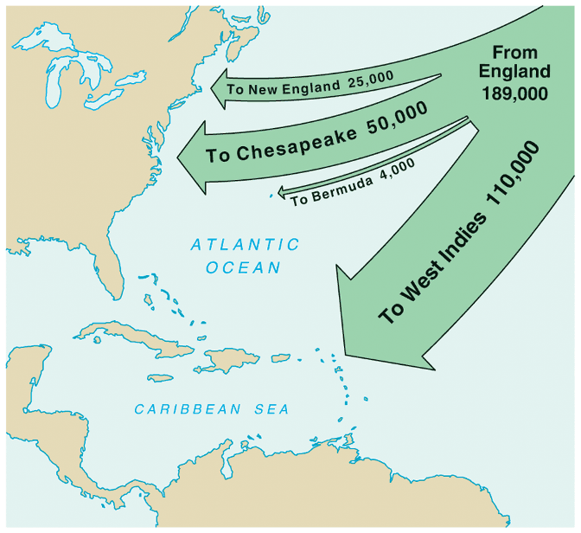
In 1618, Virginia introduced the Headright System which gave
50 acres to anyone who brought
an indentured servant to America
The large population of poor people in Britain led thousands of people to immigrating as indentured servants by 1700
Indentured servants were worked hard, treated badly,
& many died before their contracts ended
Notes:
Virginia’s growth was due largely to the headright system & indentured servitude
The status of indentured servants in early Virginia and Maryland was not wholly dissimilar from slavery. Servants could be bought, sold, or leased. They could also be physically beaten for disobedience or running away. Unlike slaves, however, they were freed after their term of service expired, their children did not inherit their status, and they received a small cash payment of "freedom dues."

Slide 12
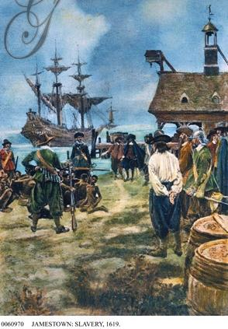
In addition to indentured servants, Virginia landowners also used African slaves who were first brought to Jamestown in 1619
In the mid-1600s, fewer indentured servants came to America as the British economy improved; As a result, African slavery replaced indentured servitude as the dominant labor system in Virginia

Slide 13
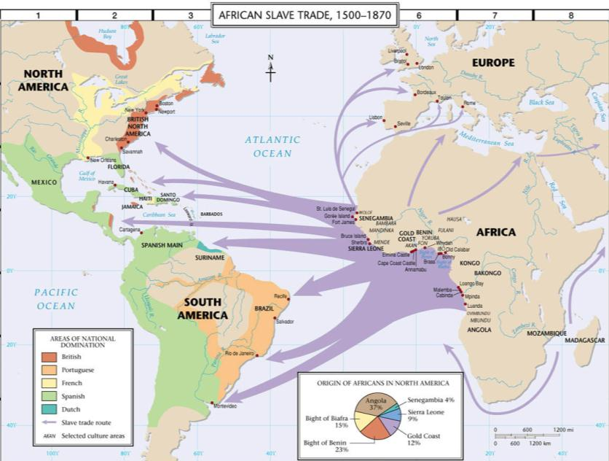
The Trans-Atlantic trade route ran from Europe, to Africa, to the Caribbean and the Americas
African slaves were transported from Africa to America on slave ships across the “Middle Passage”

Slide 14
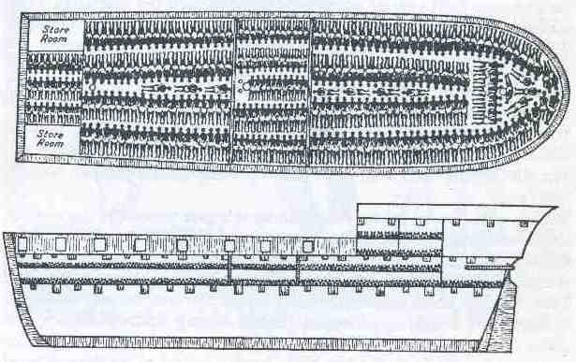
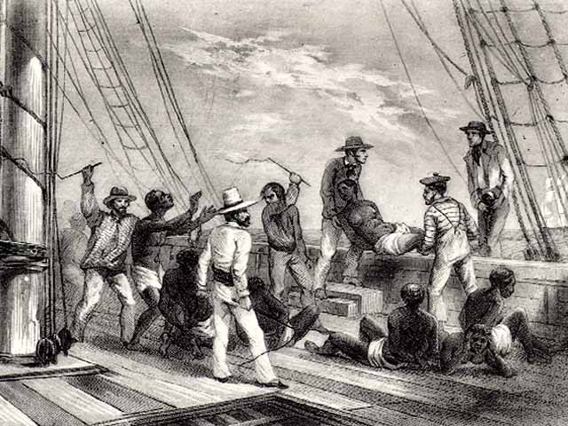
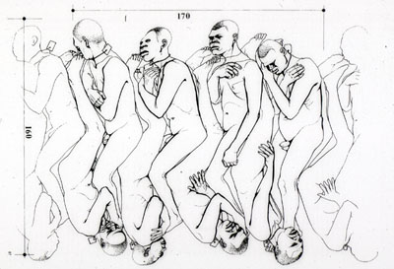
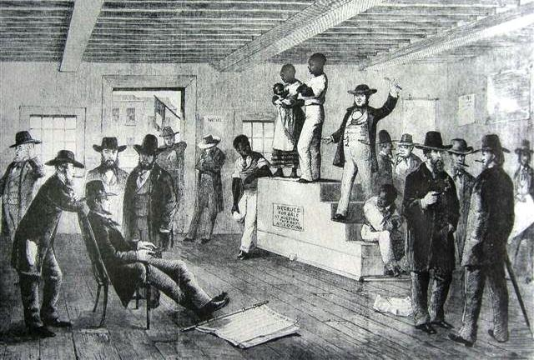
The “Coffin” Position Used Below Desk
African Captives Being Thrown Overboard
Slave auction upon arrival in America

Slide 15
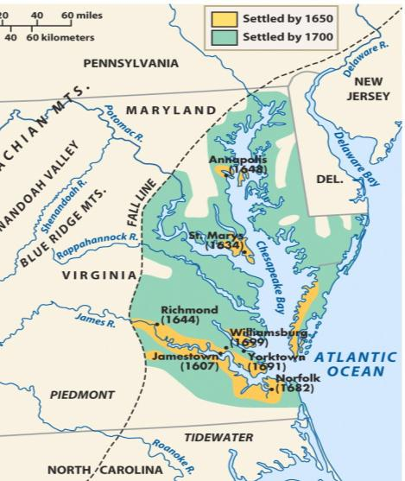
Quick discussion: As the Virginia colony grew,
it needed government. What do you think the colonial government looked like? Who had power?

Slide 16
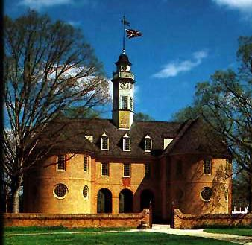
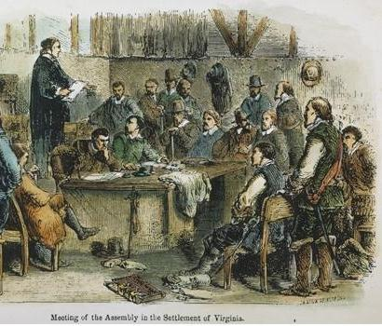
Virginia colonists needed laws to maintain order but the British government was thousands of miles across the Atlantic Ocean
In 1619, Virginians formed the House of Burgesses which was the first legislative assembly in America
Virginia was a
royal colony so it had a governor chosen by the king, but the House of Burgesses made the important decisions regarding taxes & laws

Slide 17
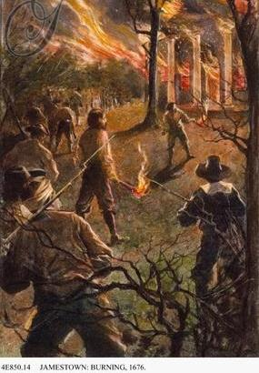
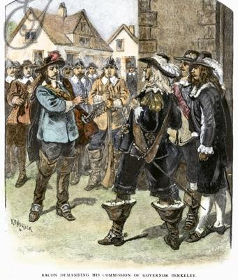
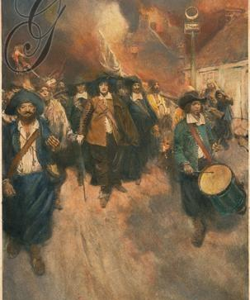
Even though the leaders of the House of Burgesses were elected, they were rich planters who did not always represent the poor farmers of the colony
Former indentured servants in western Virginia suffered from low tobacco prices & frequent Indian attacks
Poor farmers, led by Nathaniel Bacon, blamed Virginia’s governor for not protecting them & started a rebellion
Bacon’s Rebellion proved to rich Virginians that slaves were better than indentured servants because slaves would never ask for land

Slide 18
Closure Activity
Examine the “Starving Time” Primary Source Document and pick out a quote. Put that quote in your own words and illustrate what it means.
Paper and colored pencils/crayons in the front.

Slide 19
Essential Question:
  What are the differences among the Chesapeake, New England, Middle, & Southern colonies?
CPUSH Agenda for Unit 1.4:
  “Compare the British Colonies” notes

Slide 20
Benchmark Assessment
What was the first British colony in North America?
The Virginia Company is what kind of company hoping to make a profit?
Who introduced tobacco to Jamestown as a source of income?
What is an indentured servant?
What group of people replaced indentured servants as the primary source of labor in Jamestown?

Slide 21
Benchmark Assessment
What was the first successful British settlement in North America?
A group of investors that formed a company to make a profit are known as what?
John Rolfe introduced what item to the newly formed British colony as a source of income?
What was the first legislative assembly in North America?
Poor farmers suffering from low tobacco prices and frequent Indian attacks led to what event in Jamestown?

Slide 22
Benchmark Assessment
Roanoke was the first what?
What is a joint stock company?
John Smith took control of what colony?
John Rolfe introduced tobacco to the newly formed colony because it is what type of crop?
What was the House of Burgesses?

Slide 23
America: History of Us
New England (8.44)
Notes:
Describe the settlement of New England; include religious reasons, relations with Native Americans (e.g., King Phillip’s War), the establishment of town meetings and development of a legislature, religious tensions that led to the founding of Rhode Island, the half-way covenant, Salem Witch Trials, and the loss of the Massachusetts charter and the transition to a royal colony.

Slide 24
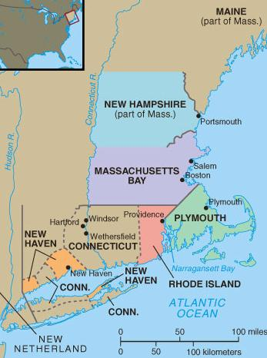
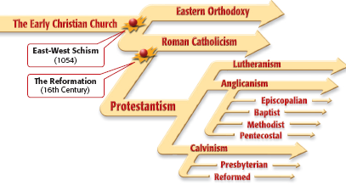
The colonists who first settled in
New England came for religious reasons
Religious disagreements
in Britain led to divisions
in the Anglican Church

Slide 25
Puritans believed in
the Calvinist idea of predestination & tried
to live strictly “Christian” lives without sin
Puritans believed that
the Anglican Church compromise too far
by allowing some
Catholic rituals

Slide 26
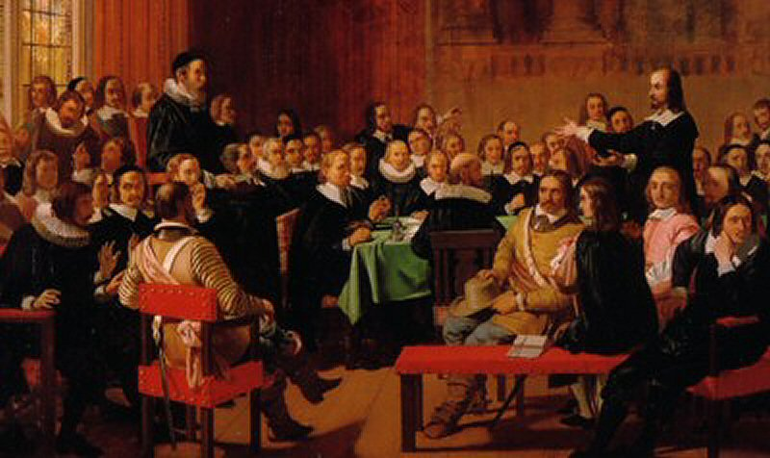
All Anglicans
Puritans
Separatists
Some radical Puritans were known as Separatists because they unwilling to wait for church reforms

Slide 27
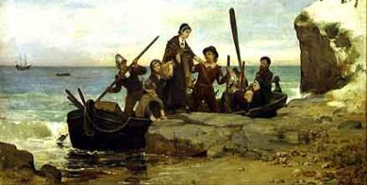
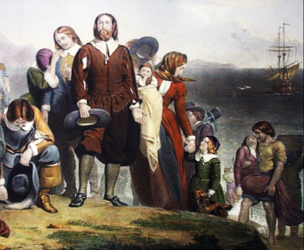
The Separatists became “Pilgrims” when they formed a joint-stock company, gained a charter,
& created the Plymouth colony in America

Slide 28
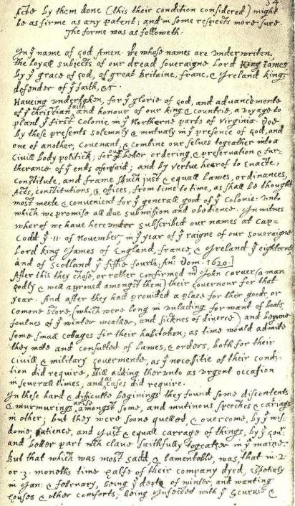
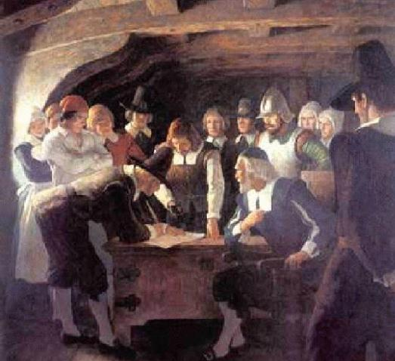
Before landing in America, the Pilgrims created the Mayflower Compact agreeing to work together
as a “civil body politick”…
…The Mayflower Compact was the first example of
self-government in America

Slide 29
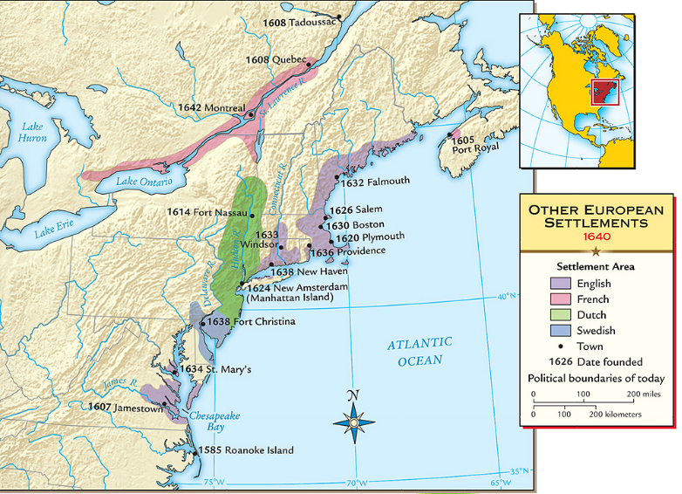
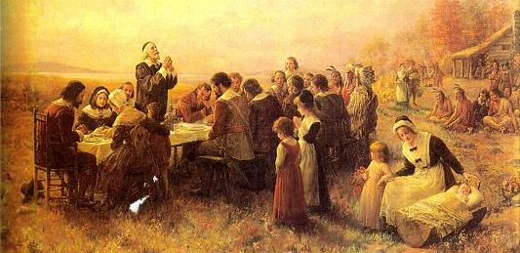
When the Pilgrims founded Plymouth in 1620,
they faced disease & hunger
The Pilgrims received help from local natives like Squanto & Massasoit…
…and celebrated the first Thanksgiving to honor the local Indians

Slide 30
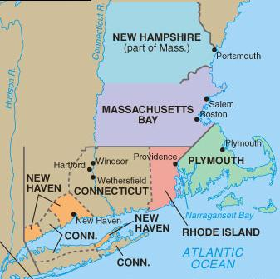
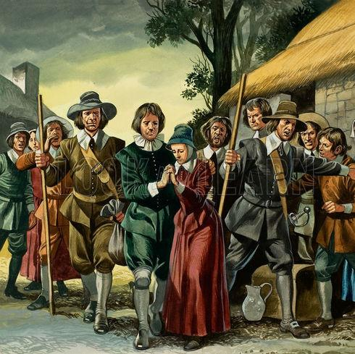
When the Separatist Pilgrims came to America, the Puritans remained within the Church of England
But when
the Catholic
King Charles I came to power, Puritans felt the time was right to leave Britain
In 1630, Puritans arrived in Boston & created the New England colony of Massachusetts

Slide 31
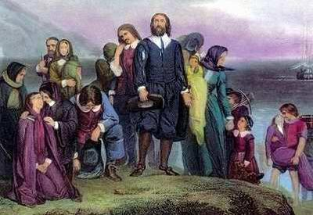
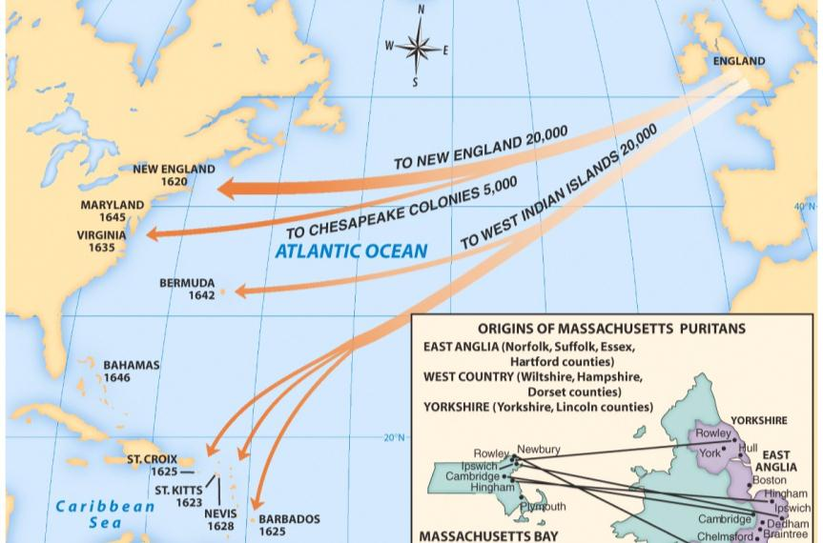
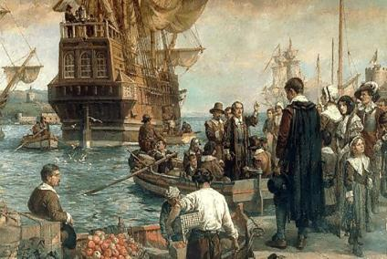
  From 1630 to 1640, Puritan leader John Winthrop led 16,000 Puritans to the Massachusetts Bay colony as part of the “Great Migration”
  John Winthrop wanted to build Boston as a
  “city on a hill” to be a model to other Christians

Slide 32
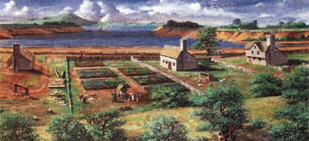
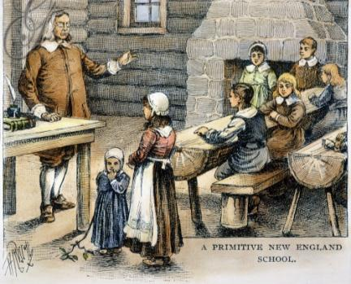
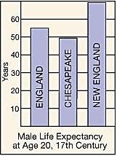


Quick discussion: Based on these images, how were the New England colonies different from Virginia?

Slide 33

  Massachusetts was a different colony from Virginia:
Puritans came to America for religious freedom
Puritan settlers usually came as families
Settlers sacrificed for the common good, built schools, & focused on subsistence farming
New England was a more healthy place to live than Virginia so colonists lived longer

Slide 34


Government in in the New England colonies centered on the church through town meetings
Each New England town was independently governed by local church members
All adult male church members were allowed to vote for local laws & taxes
Notes:
Government in Massachusetts centered on the church through town meetings:
Each Massachusetts town was independently governed by local church members

Slide 35

As the Massachusetts colony grew,
it spawned four new colonies:
New Hampshire, Rhode Island,
New Haven, & Connecticut

Slide 36

As the New England colonies expanded into new lands, conflicts with Indians arose
The Pequot War in 1637 was the 1st major British-led attack on Indians & led to the death of 600 Indians

Slide 37


King Philip’s War broke out in 1675 when
the Wampanoag Indians raided towns,
killing 10% of the colonial New England men

Slide 38

What might have caused the hysteria shown in this image?

Slide 39



New England Puritans did not like ideas that differed from their own beliefs
Roger Williams was banished from Massachusetts for demanding that Indians be paid for their land;
He formed Rhode Island in 1636
Anne Hutchinson was banished for challenging Puritan authority

Slide 40
By the 1660s,
many New England towns experienced a drop-off in
church membership
Churches responded with the Halfway Covenant which gave full church membership
to people who had not had a “conversion experience”
This compromise brought people back to the church, but showed the declining importance of religion in New England
Notes:
This compromise revealed the declining importance of religion in New England

Slide 41



Religion played a role in the Salem
witchcraft trials in 1692 when several
young girls accused people of being witches
The hysteria was caused
by tensions over land ownership, Indian attacks, & religious disagreements
As a result of the trials,
19 people were killed & 150 citizens were jailed

Slide 42
Label on map:
(a) Plymouth
(b) Massachusetts (c) Rhode Island
(d) Connecticut
(e) New Hampshire
(f) Group and label
the five New
England colonies
(g) Label why the
New England
colonies were
founded

Slide 43


Slide 44

The
Middle &
Southern Colonies
Notes:
Explain the development of the mid-Atlantic colonies; include the Dutch settlement of New Amsterdam and subsequent English takeover, and the settlement of Pennsylvania.

Slide 45

In what ways might Pennsylvania be different from other British colonies?

Slide 46


Pennsylvania was founded by William Penn in 1681

Slide 47

Penn was a member of
a religious sect called Quakers who believed
in the “Inner Light,” all people are equal, & that people can communicate directly with God

Slide 48


Penn founded his colony
as a “holy experiment” to promote religious toleration
He bought land from the Indians, banned slavery,
& allowed a diverse population to move there

Slide 49

The middle colonies
had two of the best ports for trade in America: Philadelphia & New York

Slide 50


The 1st “middle” colony was New Netherland created by the Dutch West India Company
To attract settlers, the Dutch recruited Swedes, Germans, & Africans; New Netherland became very diverse
Britain did not like the Dutch a colony between their Chesapeake &
New England colonies
In 1664, Britain seized the Dutch colony from Governor Stuyvesant & renamed it New York
Dutch governor Peter Stuyvesant resisted Britain’s takeover of New Netherlands but could not get the colonists to assist him
Notes:
Explain the development of the mid-Atlantic colonies; include the Dutch settlement of New Amsterdam and subsequent English takeover, and the settlement of Pennsylvania.

Slide 51

The image below is from the “Lower South” colony of South Carolina. Which other colony might it be similar to? Why?

Slide 52




The Southern colonies were the last British colonies to be formed
The Carolinas & Georgia developed like Virginia with a cash crop economy, slavery, & gaps between rich & poor colonists
Georgia was created by James Oglethorpe as a buffer colony between Carolina & Spanish Florida & was populated by British debtors & prisoners

Slide 53


Maryland was founded in 1632 by Lord Baltimore (Lord Calvert)
It was created as a safe haven for English Catholics
Maryland’s economy developed because of the cash crop tobacco

Slide 54
Label on map:
(a) New York
(b) Pennsylvania
(c) North Carolina
(d) South Carolina
(e) Georgia
(f) Group and label
the Middle & Southern colonies
(g) Label why these
colonies were
founded

Slide 55
Closure Activity
Complete “Comparing the
American Colonies” chart

